Slide 1

MODULE 4 – LAB 1: FIGMA
FIGMA PROTOTYPE FOR A SCOAL MEDIA APPLICATION

Slide 2
REQUIREMENTS:
Create a Figma prototype for a social media application, where you can post your content and posts from other users are visible. Don’t just jump into Figma, try to follow the design procedure.
It could be a social media application designed for a specific community.

Slide 3
Requirements:
I designed a social media prototype for a community of sustainable consumers interested in companies’ sustainable/responsible products.
The social media prototype includes:
Featured pics of sustainable/responsible products photos sponsored by companies on the welcome page.
Hot updates on the relevant focus of the community.
Posts of the members (and the reactions from other members).
The name of the social media is ‘InsMe’ (Inspire Me).

Slide 4
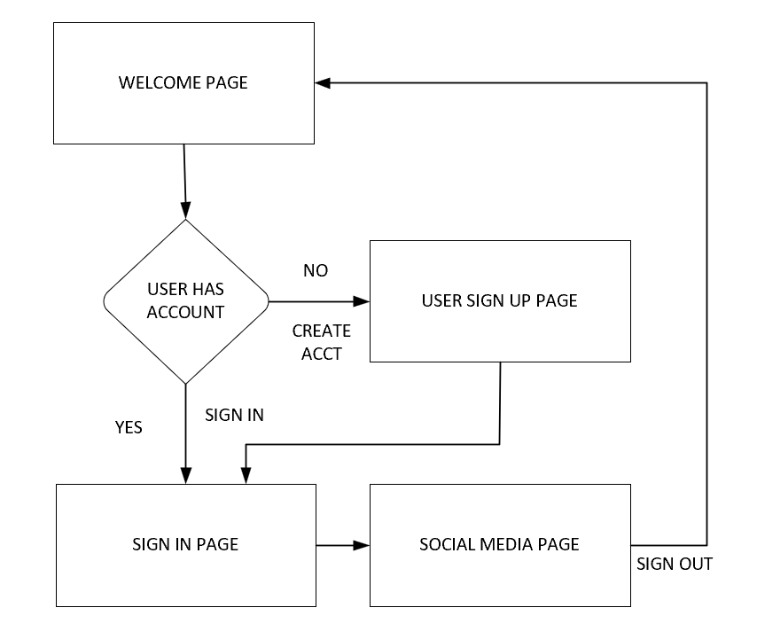
Application design

Slide 5
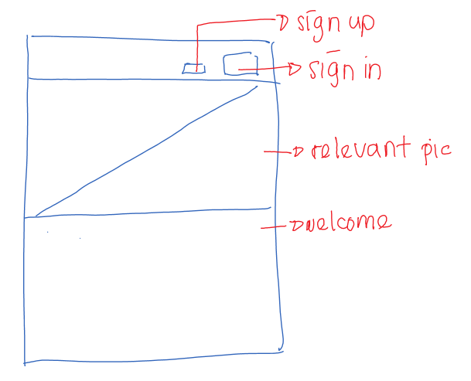
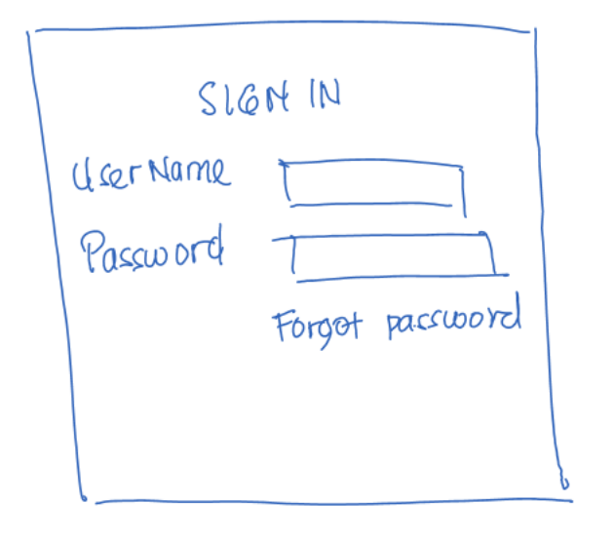
Sketch: initial design idea
Page 1
Page 2

Slide 6
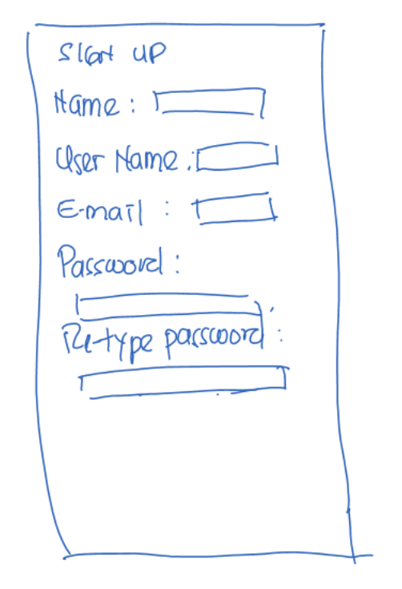
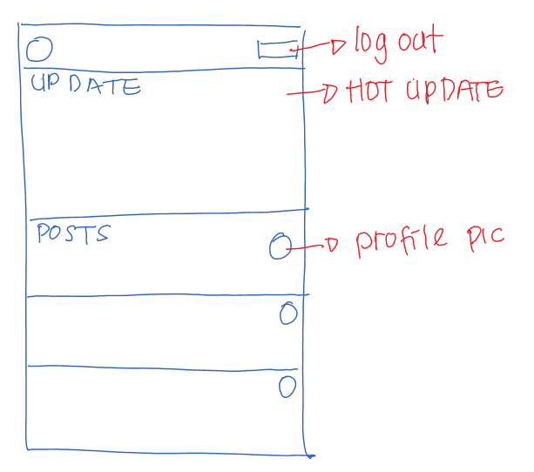
Sketch: initial design idea
Page 3
Page 3

Slide 7
Figma: Lo- Fi
Prototype Link:
https://www.figma.com/proto/FcIqhe8fZck2ax3Kxn3Qmq/Lo-Fi?node-id=0-1&t=XYIzqeZ7DGMNkiJU-1

Slide 8
Figma: hi-fi
Prototype Link:
https://www.figma.com/proto/0Cx3kIBTeINUUyju2yUtXE/Hi-Fi?node-id=0-1&t=AfCjP5zu6b6t3Len-1

